Slide 1
Knowledge Graph Embedding & Question Answering
KG Embedding and QA
KG Embedding and QA – 2 solutions for Ontology KG
User Manual to KG Embedding (UM to KG)
UM to KG – Problems to solve
UM to KG – Big Picture of solution
UM to KG – Approaches Tried and Learnings
UM to KG – Next Step
2021/01/22
India SW Lab

Slide 2
Knowledge Graph Embedding & Question Answering
Graph embeddings preserve the global relationship present in the Graphs, can be used for downstream task such as Question Answering.
Question Answering using KGs:
  Simple Question Answering: Identification of correct factoid (head, predicate, tail) present in the KG. Single-hop is required.
  Eg. (Barack Obama, birth place, Hawaii)
  Complex Question Answering: Answering such questions require multiple hop over, more than one factoids to reach the answer.
  Eg. (Barack Obama, birth place, Hawaii), (Hawaii, state, of country America)

Slide 3
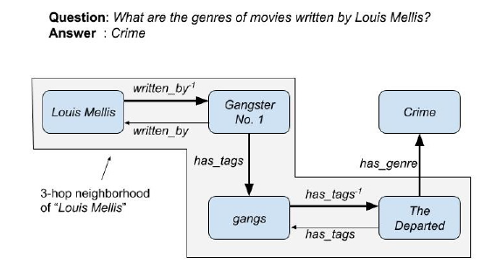
Simple and Multi-hop Question Answering
Available:
  Simple Question Answering:
    Paper: Knowledge Graph Embedding Based Question Answering
    Detect head, predicate embeddings from questions. Search over KG to find a factoid with match, tail is the answer
  Multi-hop Question Answering:
  Paper: Improving Multi-hop Question Answering over Knowledge Graphs using Knowledge Base Embeddings

Slide 4
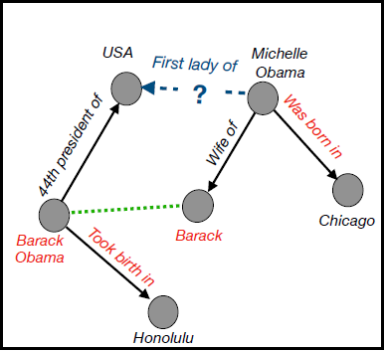
Path: Unstructured Manuals to Knowledge Graph
  Question answering over KG approaches uses Ontological Knowledge Graphs such as freebase, yago, Dbpedia.
  LG Manuals contain Unstructured Data. KG is not available. Ontology is not defined.
  Steps required:
    Convert Unstructured Manual to KG
    KG to Question Answering

Slide 5
Path: Problems to be solved and Challenges
  Problems to be solved for KG creation:
    Entity Extraction
    Relation Extraction
    Entity Mapping (Canonicalization/Normalization)
    Relation Canonicalization (was born in, took birth in=> birth_place)
  Challenges in Manual specific KG creation:
    Entities specific to Manuals are domain specific. NER systems trained on open domain data fail to identify those entities. (https://demo.dbpedia-spotlight.org/)
    Defining pre-specified Ontology is cumbersome. Open KGs do not require pre-specified ontology, makes them highly adaptable.
    All questions from Manuals are not factoid questions. Most of the questions, require descriptive answers, phrases. Treating concepts(block of sentence, sentence, named entities) as entities could be helpful.

Slide 6
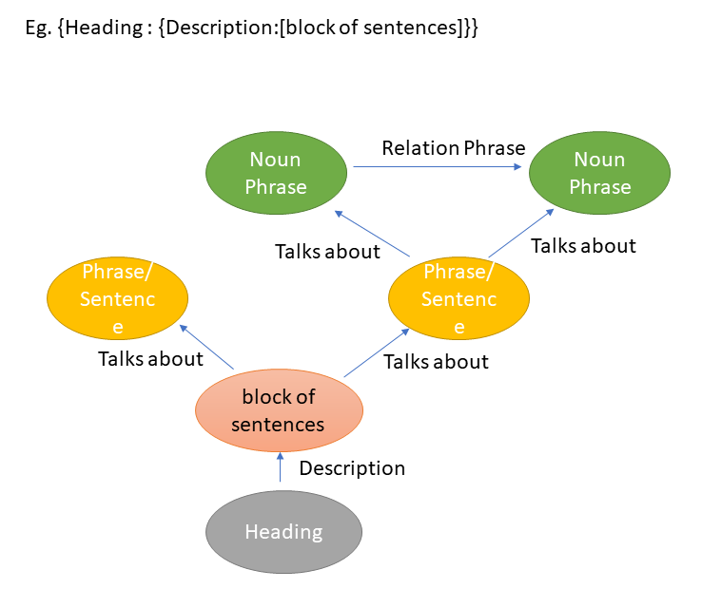
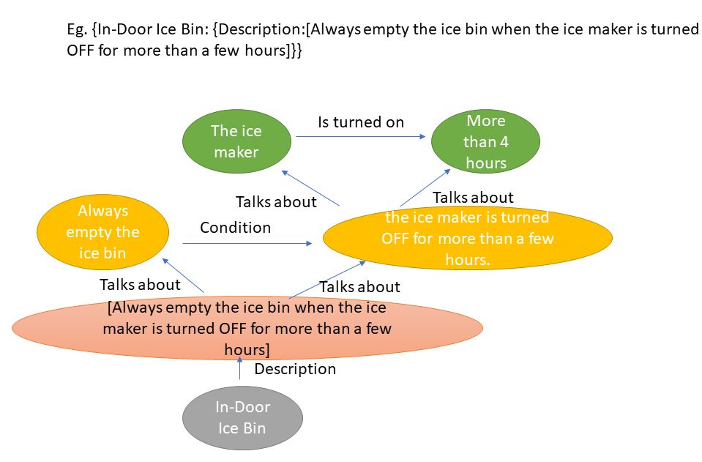
The Bigger Picture
Analysis on Manuals depicts three levels of Hierarchy :
  Relation between a section and subsection, or subsection and paragraph. Eg. Steps to use certain functionality.
  Relations depicted between two clauses (Discourse Relation) within same sentence.
  Relations extracted from a sentence. IE tools can extract sentences automatically from sentences in the form of triples.

Slide 7
Entity/Relation Extraction : Progress of the Approaches Tried and learnings
NER to Extract Entities, Coreference , OPEN IE information extraction tool on Unstructured Manual
  Remark: Too many granular relations. Difficult to trace the context. OPEN IE also extracts many relations, that makes extraction Noise. NER system misses out many domain specific entities. IE tools perform poorly on relation extraction from imperative sentences, as this tools are trained on data mostly contains declarative sentences.
Replace OPEN IE with OLLIE, Include Dependency Parse for Relation extraction
  Remark: OLLIE is better in terms of reducing Noise. Dependency Parse helps pruning. Context is still missing. Relation among phrases is missing
Treat Entities as Concepts with Hierarchy. Top level relations (between section and Paragraph) were annotated. 13 types of discourse relations are defined and extracted by inclusion of Constituency Parser. OLLIE is replaced with state-of-the art OPENIE5.1
  Remark: OpenIE5.1 uses Berkeley Language model, extracts more sensible relations from sentences, reducing noise. Top level relations and Discourse relations between clauses ensures the context). Relation Extraction from, imperative sentence is still challenge for OPENIE5.1.

Slide 8
Entity/Relation Extraction : Plan for Next Step
Use presently extracted relations and use the approach mentioned in the paper CaRe: Open Knowledge Graph Embeddings to obtain the Graph Embeddings for Open KG. For Entity Linking/ Canonicalization we may use CESI: Canonicalizing Open Knowledge Bases using Embeddings and Side Information
Create Graph Embeddings for both Simple and Multihop Question answering for Open KG

Slide 9
Thank you
&
Have a Great Day!!

Slide 10
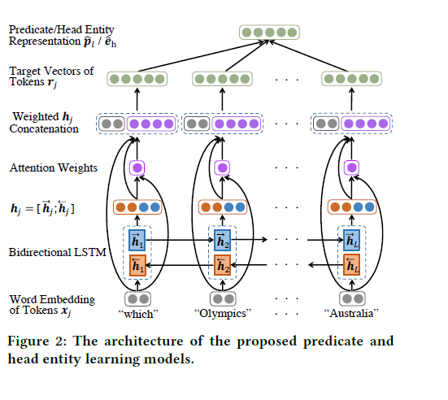
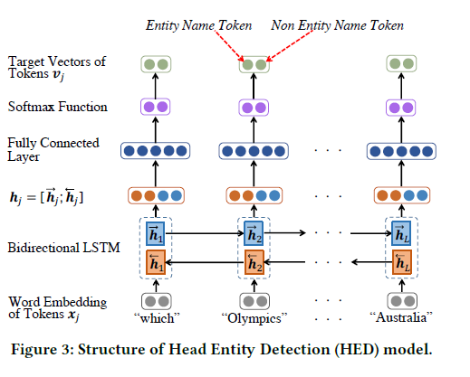
Appendix 1 : Simple Question Answering on Ontology KG
The results from this paper Knowledge Graph Embedding Based Question Answering is reproduced.

Slide 11
Appendix 1 : Simple Question Answering on Ontology KG: Demo question and answers
Results:
Please Ask Question:
What is the capital of India?
new delhi
Please Ask Question:
what is the capital of england ?
london
Please Ask Question:
who is the director of the movie titanic ?
james cameron

Slide 12
Appendix 2 : Logs Entity/Relation Extraction : Progress of the Approaches Tried and learnings

Slide 13
Appendix 3 : Logs Entity/Relation Extraction : Progress of the Approaches Tried and learnings
Approach 1:
  This approach combines the following tool chains:
    Named Entity Recognition to extract entities
    Coreference resolution to track the entity mentions
    Open information extractions to extract triples from sentences
  Scope: This method was tried on open domain (Extracted article from Wikipedia)
  Sample example:
    Sentence: “Kolkata is known as the "cultural capital of India" for the city's historical and architectural significance.”
    Extracted triples:
  Remarks
    It generates noisy redundant triples, also extraction tool misses out important triples.
Kolkata | is known as | cultural capital of India
Kolkata | is known as | cultural capital
Kolkata | is known as | capital for city 's historical significance
Kolkata | is known as | cultural capital for city 's historical significance

Slide 14
Appendix 3 : Logs Entity/Relation Extraction : Progress of the Approaches Tried and learnings
Approach 2:
  This approach is relies mainly on rule-based dependency parsing to extract information, along with OPEN IE, NER and coreference modules. It also prunes unnecessary relations.
  Scope: This method was tried on open domain (Extracted article from Wikipedia) as well as Manual specific .
  Sample example:
    Sentence: “Kolkata is known as the "cultural capital of India" for the city's historical and architectural significance.”
    Extracted triples:
    Sentence: “The washer automatically adjusts the wash time for the amount of laundry, water pressure and other operating conditions. ”
Head | Rel | Tail
Kolkata | is known as | cultural capital of India
Head | Rel | Tail
washer | automatically adjusts | wash time

Slide 15
Appendix 3 : Logs Entity/Relation Extraction : Progress of the Approaches Tried and learnings
Approach 2:
  Remarks
    Extracted relations are granular in nature. The context is not clear from the extracted relation. Eg. (Cycles, are available at, same time) is one of such extracted triples for Washer manual. It is missing the context of the entity ‘cycle’, also the reference to ‘same time’ to the event. It also does not capture the Topic or Heading this triple is related to.
    Data is available atThe detailed log is available at :Log : https://drive.google.com/file/d/19BSTA0lA1Dg0gz87h-6UnjvjVKges1pL/view?usp=sharing
    Data : https://drive.google.com/file/d/1ItAMT6wZx3B4ASVcq8Rf1MTFw_bOAFTA/view
    OPEN IE extracts a lot of noises, only using dependency parser yields better results: (https://drive.google.com/file/d/100QnPnC8qobJvUQPMryfHNktN0CCNYEj/view)
    Better information Extraction tool is needed.

Slide 16
Appendix 3 : Logs Entity/Relation Extraction : Progress of the Approaches Tried and learnings
Approach 3:
  This approach is from paper reference https://www.researchgate.net/publication/328758214_Semantic_Role_Labeling_for_Knowledge_Graph_Extraction_from_Text :
  Sample example:
    Sentence: “New Delhi is the capital of India. India has a population on 1 billion. India has 29 states and 7 union territories..”
    Extracted triples:
  Remarks:
    Misses out important information. We discard this approach.
nsubj | has-2 | India-1
dobj | has-2 | states-4

Slide 17
Appendix 3 : Logs Entity/Relation Extraction : Progress of the Approaches Tried and learnings
Approach 4:
  In this approach, we annotate the input data, to capture the relations between heading and subheadings and text within subheadings. NER + Coref + Open IE+ Dependency Parse + Pruning were applied at the unstructured text block .
  Extracted triple output are available at:
      https://drive.google.com/file/d/1-YviExyIMzzg0eOxRPwlnK-vUSbDLU1I/view
  Remarks:
    It captures the over all picture (context) and also the relations on sentence level.
    A lot of manual (domain Specific)specific entities are not identified by Spacy Named Entity Recognition.
    Unlike Freebase, the Manual specific question answers are not factoid based. Relations within clauses(Discourse relations) are not captured. Eg. “Contact an authorized service centre when installing or relocating the refrigerator.” Note that, the clauses ‘installing or relocating the refrigerator ’ and ‘Contact an authorized service centre’ has a relationships which is not captured by IE. Also the Clauses are not traditional entities like Noun Phrases. For QA system, we also need to address the relationship between clauses in a sentence

Slide 18
Appendix 3 : Logs Entity/Relation Extraction : Progress of the Approaches Tried and learnings
Approach 5:
  It is an improvement over approach 4, we added OLLIE as information tool and utilized Constituency parsing to extract relations on clause level as well. The resultant KG is an OPENKG, with three different levels of hierarchy on heading-to-subheading, subheading-to-textblock, textblock-to-sentences, sentences-to-clauses, clause-to-clause, entity-to-entity.
  Extracted triple output are available at:
      https://drive.google.com/file/d/19BdgrDsD7jfNEHj39PTPku1dF6Q0mXPz/view?usp=sharing
  Remarks:
    Improvement on Approach 4, to include discourse relations within sentence.
    Coref would be incorporated later, once en-to-end IE structure defined
    Entities in manual specific cases are not Named Entities, rather they are concepts. Concept could be a block of text, a sentence, a Noun Phrase, or a proper entity

Slide 19
Appendix 3 : Logs Entity/Relation Extraction : Progress of the Approaches Tried and learnings
Approach 6:
  It is an improvement over approach 4, we replaced OLLIE with IE5.1, as IE5.1 is latest SOTA and an improvement over OLLIE, keeping other components of the tool chain intact. as information tool and utilized Constituency parsing to extract relations on clause level as well. The resultant KG is an OPENKG, with three different levels of hierarchy on heading-to-subheading, subheading-to-textblock, textblock-to-sentences, sentences-to-clauses, clause-to-clause, entity-to-entity.
  Extracted triple output are available at:
    https://drive.google.com/file/d/1ewSB4IkVlYLRCYZrF9kGs9jNwhBWSu1H/view?usp=sharing
  Remarks:
    Improvement on Approach 5, to include 13 types of discourse relations within sentence
    OPENIE 5 is current state of the art Information extraction tool based on Berkeley Language Model
    Three steps for relation Extraction :
      a) Extract defined relation from Semi-Structured Data
      b) Extract 13 types of Discourse relations from sentences
      c) Open IE5 extracts relations from sentences

